Slide 1
An introduction to macro writing in ImageJ/Fiji
Dr. Dominic Alibhai & Dr. Stephen Cross
Slides, test data and demo macros can be downloaded from http://goo.gl/urxwo9

Slide 2
Overview
Brief introduction to macro writing
What are macros?
Fundamental concepts in programming
Demonstrated examples in the context of ImageJ/Fiji
Short break
Hands on exercises to create a macro for image segmentation and analysis
Loading images from file
Displaying user interface elements (options boxes)
Macro 1

Slide 3
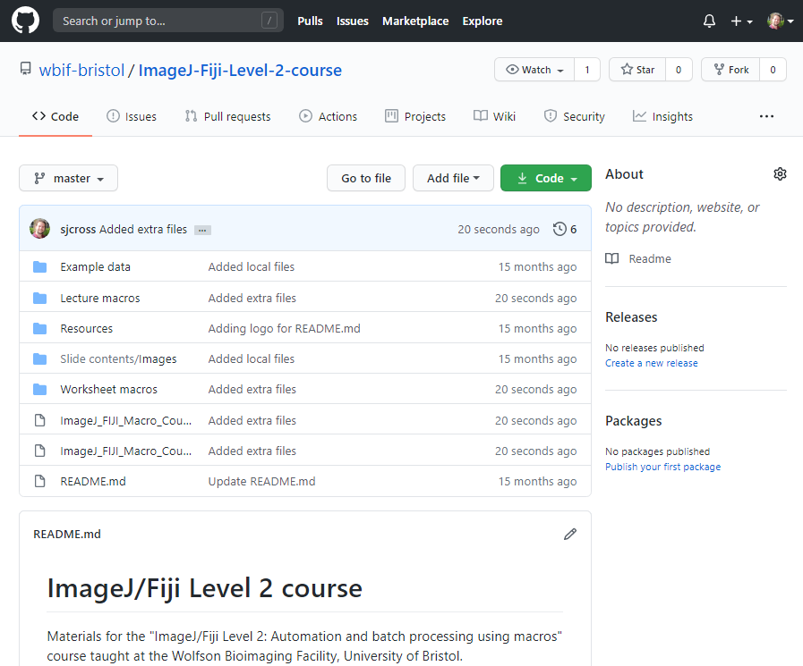
Course materials
Images used in lecture and worksheet
Download all course material (zip format)
Example macros shown during lecture
Model solutions to worksheet exercises
Lecture slides (PowerPoint format)
Worksheet
(Word format)
https://github.com/wbif-bristol/ImageJ-Fiji-Level-2-course

Slide 4
Where to get help
Introduction to macros by NIH
http://imagej.net/Introduction_into_Macro_Programming
https://imagej.nih.gov/ij/docs/macro_reference_guide.pdf
Complete list of macro commands
https://rsb.info.nih.gov/ij/developer/macro/functions.html
Wolfson Bioimaging!
Stephen: stephen.cross@bristol.ac.uk
Dom: da14205@bristol.ac.uk
Office: C31 (Biomedical Sciences Building)

Slide 5
Introduction to macros
What is a macro?
A sequence of commands that automate a series of processing steps in ImageJ
Each command calls a particular ImageJ function
e.g. cropping an image stack, applying a filter, calculating the FFT
Why use macros?
Avoids having to manually apply the same processing steps to multiple images
One macro can be applied to folders containing hundreds of images
Can extend ImageJ functionality
Access individual pixel values
Apply basic programming approaches (loops, conditional statements, functions)

Slide 6
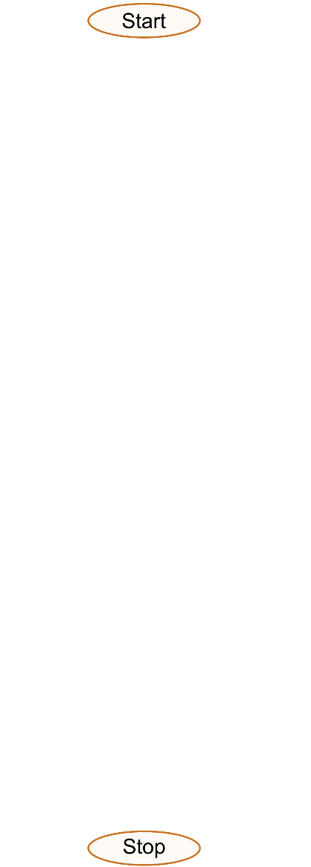
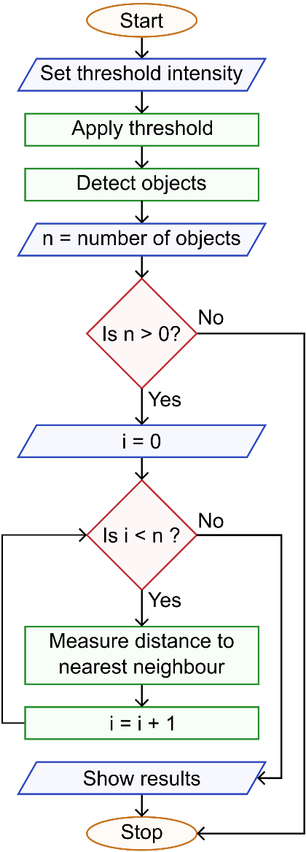
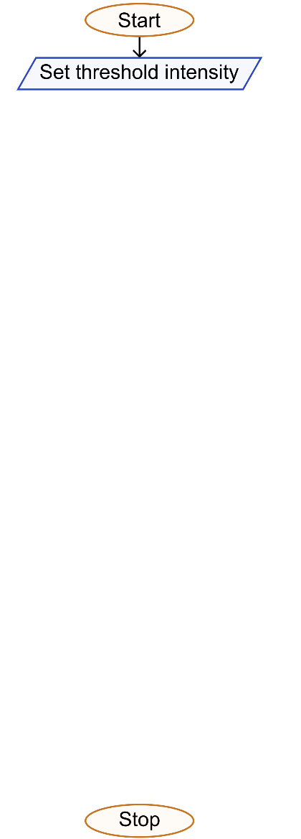
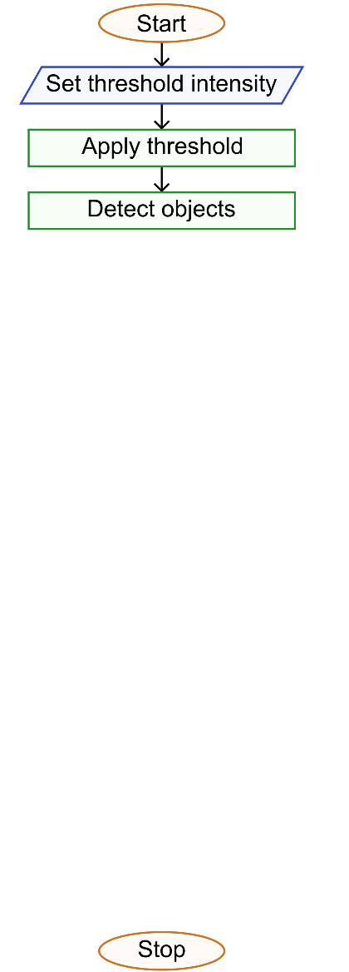
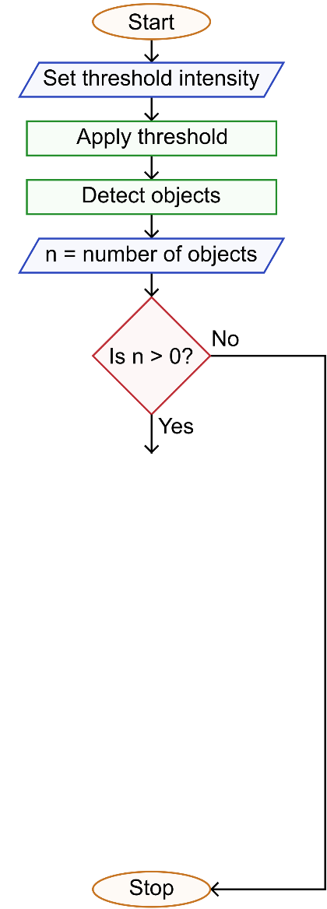
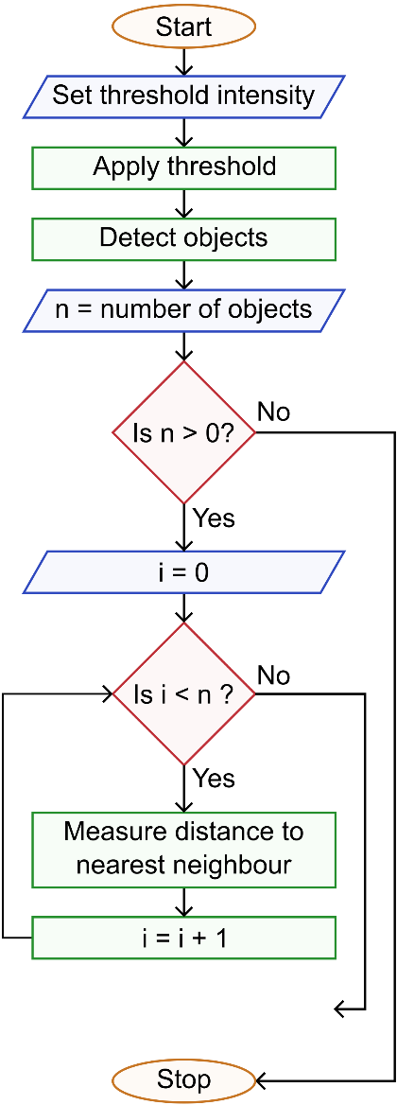
Structure
Linear sequence of commands
Execution can be depicted in a flow diagram
Operations can be considered to fall into classes
Input operations
Processing operations
Conditional statements
Loops
Output operations

Slide 7
Hello World
Displaying information
At any point in a macro’s execution you may want to get information
e.g. number of objects detected
ImageJ can display messages in the log window
Example code using text
print("Hello World!") displays “Hello World!”
Example code using numbers
print(42) displays “42”
Macro 1

Slide 8
Two things before we go further
Semicolons (;)
End each command with a semi colon
This tells ImageJ where one command ends and another begins
Set the foreground/background logic
ImageJ can be set to consider “background” as either white or black
Each macro should start by standarising this
The ImageJ default is black objects, white background)
setOption("BlackBackground", false);

Slide 9
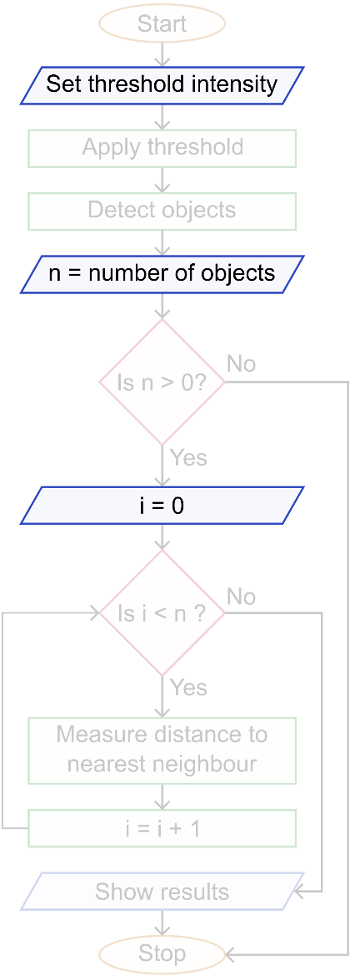
Variables
Variables act as temporary stores of information
Formed of a reference (identifying name) and a value
Stored value can be recalled later on using reference
Reference (identifying name) defined by the user
No two variables can have the same name
Assigned a value at creation
This can be updated/changed later on

Slide 10
What can be stored in variables?
Numbers
e.g. number of objects detected in an image
Strings
Sequence of text characters
e.g. name of smoothing filter
Arrays
1-dimensional list of numbers or strings
Equivalent to a column in a spreadsheet
e.g. list of open image names

Slide 11
Working with number-type variables
Declaring number-type variable
num_var = 42;
Calculations using number-type variables
Can apply standard mathematical operations
Example of using number-type variables
my_var_1 = 10;
my_var_2 = 5;
my_var_3 = (my_var_1 + my_var_2) * 7;
my_var_3 has value of 105
Macro 2

Slide 12
Working with string-type variables
Declaring string-type variable
string_var = “your string”;
Example of using string-type variables
my_var_1 = “first string”;
my_var_2 = “second string”;
my_var_3 = my_var_1 + “ ” + my_var_2;
my_var_3 has value of “first string second string”
Process of joining strings called “concatenation”
Macro 3

Slide 13
Working with array-type variables
Declaring empty array-type variable
array_var = newArray([size]);
[size] is an integer specifying the number of elements in the array
Array will be filled with zeroes
Values can be added later on
Declaring populated array-type variable
array_var = newArray(42.0, 2.9, 56.3, 43.2);
array_var = newArray(“str1”, ”str2”, “str3”);
Values can be changed later on
Notes:
Why would you want to do this?

Slide 14
Working with array-type variables
Storing data in arrays
Data can be stored in a particular element (row) using its index
ImageJ is “zero-based”, meaning the first row has an index of zero
my_array = newArray(3);
Examples of storing data
my_array[0] = “string to store”;
my_array[1] = “another string”;
my_array[2] = “final string”;
index
“string to store”
“another string”
“final string”
0
my_array =
1
2

Slide 15
Working with array-type variables
Accessing data in arrays
Each element of the array accessed using its index (row number)
my_array = newArray(42.0, 2.9, 56.3, 43.2);
Examples of accessing data
num_from_array_1 = my_array[0];
num_from_array_1 has a value of 42.0
num_from_array_2 = my_array[2];
num_from_array_2 has a value of 56.3
index
42.0
2.9
56.3
43.2
0
1
my_array =
2
3
Macro 4

Slide 16
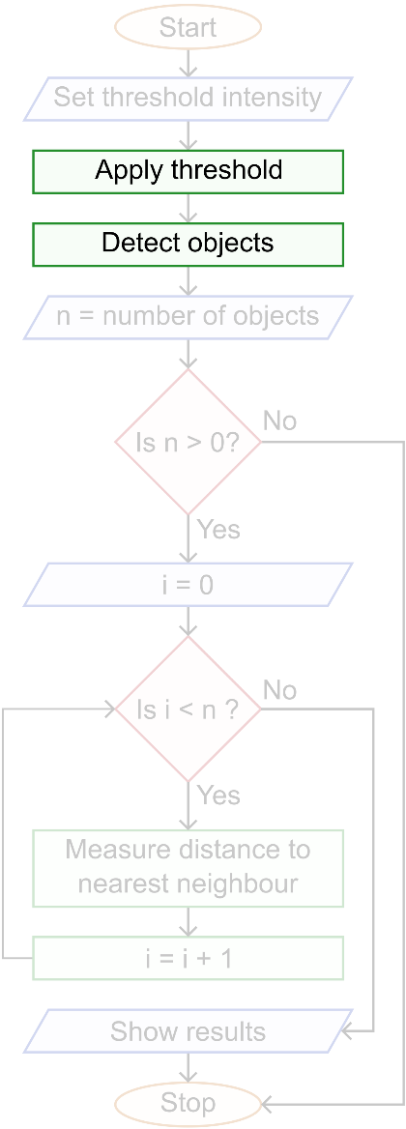
Functions
A function “call” runs an operation in ImageJ
General structure
Returned value
Output from the function can be a number, string or array
Can be used directly or stored in a variable
Function name
Arguments
Parameters required by the function for it to work
Multiple arguments separated by commas
returned_val = functionName(arg_1, arg_2, arg_3);

Slide 17
However!
Not all functions return values or take arguments
It’s good practice to still include the parenthesis
e.g. close() closes the active image
A few functions assign values to the arguments
They arise because you can only return one value from a function
e.g. getDimensions(width, height, n_channels, n_slices, n_frames);
Complete list of macro commands
https://rsb.info.nih.gov/ij/developer/macro/functions.html

Slide 18
Example functions
Getting value of a pixel
getPixel(x,y) returns the intensity of the pixel at coordinates x,y
pixel_val = getPixel(42,6);
Renaming an image
rename(name) accepts a string and changes the window name
rename(“My image”);
Calculating sine of an angle
sin(angle) returns the sine of the specified angle (in radians)
returned_val = sin(0.32);

Slide 19
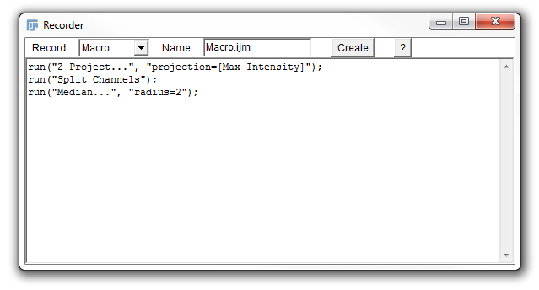
Finding functions
Complete list of macro commands
https://rsb.info.nih.gov/ij/developer/macro/functions.html
Macro recorder
Plugins > Macros > Record…
Records the commands processed
by ImageJ when functions are run

Slide 20
Code completion (Fiji script editor)
Fiji script editor will give suggestions as you type
Includes a short description of the function

Slide 21
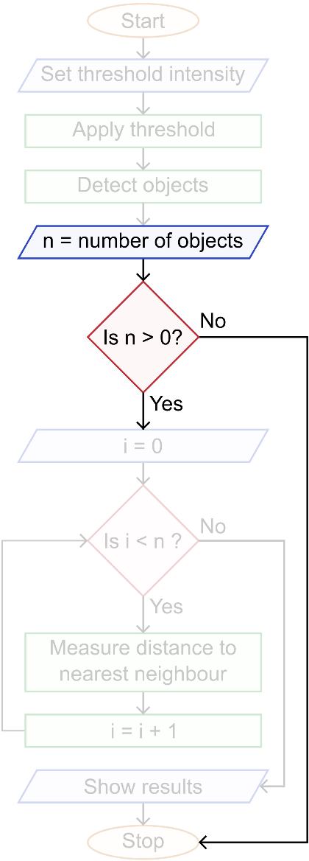
Conditional statements
Controls whether segment of code executes
Also referred to as “if statement”
If condition not met, corresponding code is skipped
Structure of conditional statement
Statement always begins with “if”
Execution of code dependent upon criteria specified in brackets
Code to be executed contained within “curly” brackets
By convention, for readability this block of code is indented
if ([condition]) { [code to execute] }

Slide 22
Conditional statements
If an “if” condition isn’t met, can use “else” as a fall-back
“else if” will evaluate if the “if” fails, but another condition is met
“else” will evaluate if all “if” and “else if” conditions fail
a = 1;
if (a >= 3) {
[this condition isn’t met]
} else if (a == 2) {
[this condition isn’t met either]
} else {
[this code will execute]
}
Macro 5

Slide 23
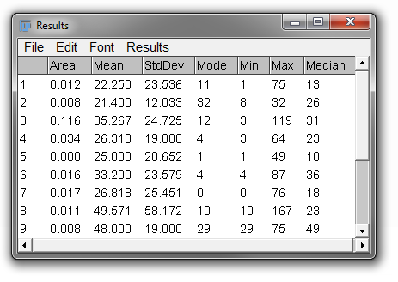
Conditional statements
Another example conditional statement
Having previously run “Analyze particles”
Get results table window, where each row corresponds to a different particle
Use nResults() function to get number of rows (particles)
Assign returned value to num_objects variable
Check if at least one particle detected
num_objects = nResults(); if (num_objects > 0) { [code to execute] }

Slide 24
Conditional operators
Commonly used conditional operators
Chain conditions together with && and ||
if (a > 1 && b <= 2) { [code to execute] }
== | Equal to
!= | Not equal to
< | Less than
<= | Less than or equal to
> | Greater than
>= | Greater than or equal to
&& | And
|| | Or

Slide 25
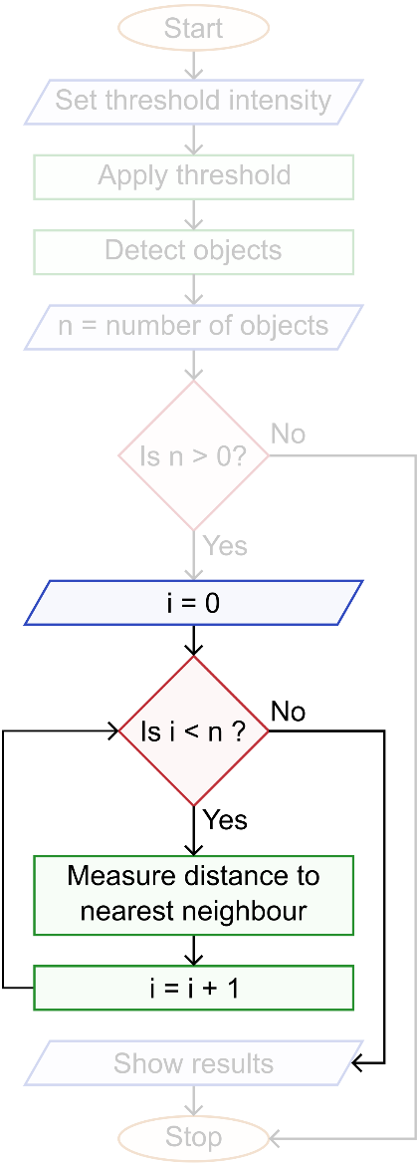
Loops
Repeatedly execute the same block of code
Loops can be nested (placed inside each other)
“While loops”
Keep executing until a condition is met
e.g. Reducing intensity threshold until objects are detected
“For loops”
Run a pre-determined number of times
Each loop has a counter which keeps track of the number of runs
e.g. The code executes once for each row in the results table

Slide 26
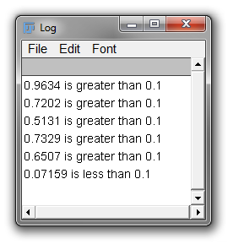
While loops
Statement always begins with “while”
Condition for continuation specified in brackets
Code to be executed contained within curly brackets
random_number = random();
while (random_number > 0.1) {
print(random_number + " is greater than 0.1");
random_number = random();
}
print(random_number + " is less than 0.1");
Macro 6

Slide 27
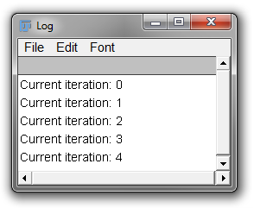
For loops
Statement always begins with “for”
Options for run specified in brackets (separated by semicolons)
First, the counter starting number (typically 0)
Second, the stopping condition
Third, the behaviour of the counter (i++ adds 1 on each run)
Code to be executed contained within curly brackets
Can refer directly to counter variable
for (i = 0; i < 5; i++) {
print(“Current iteration ” + i);
}
Macro 7

Slide 28
Nesting loops
Loops and statements can be put inside each other
This is also called “nesting”
for (i = 0; i < 10; i++) {
for (j = 0; j < 3; j++) {
print(“ValueA = "+i+“, ValueB = "+j);
}
}
ValueA = 0, ValueB = 0
ValueA = 0, ValueB = 1
ValueA = 0, ValueB = 2
ValueA = 1, ValueB = 0
ValueA = 1, ValueB = 1
ValueA = 1, ValueB = 2
ValueA = 2, ValueB = 0
…
ValueA = 9, ValueB = 1
ValueA = 9, ValueB = 2

Slide 29
Nesting loops (example)
for (i = 0; i < n_{frame1}; i++) {
for (j = 0; j < n_{frame2}; j++) {
Measure distance between points “i” (fr. 1) and “j” (fr. 2)
}
}
2A
2B
2C
2D
1A
2A
7
2
2A
1B
1A
6
10
2B
2B
1C
1B
1
6
4
10
i = 0
i = 1
i = 2
i = 3
2C
2C
j = 0
j = 1
j = 2
j = 3
1D
1C
3
7
2
7
2D
2D
1D
7
5
4
3
Frame 1
Frame 2
Point-point distances

Slide 30
Nesting loops (example)
i = 0
i = 1
i = 2
i = 3
j = 0
j = 1
j = 2
j = 3
for (i = 0; i < n_{frame1}; i++) {
for (j = 0; j < n_{frame2}; j++) {
Measure distance between points “i” (fr. 1) and “j” (fr. 2)
}
}
2A
2B
2C
2D
1A
2A
7
2
2A
1B
1A
6
10
2B
2B
1C
1B
1
6
4
10
2C
2C
1D
1C
3
7
2
7
2D
2D
1D
7
5
4
3
Frame 1
Frame 2
Point-point distances

Slide 31
Overview
Here we will go through a series of examples to put into practice some of the elements discussed by Stephen
The provided worksheet will guide you through each exercise
We will break between each exercise to go through a possible solution

Slide 32
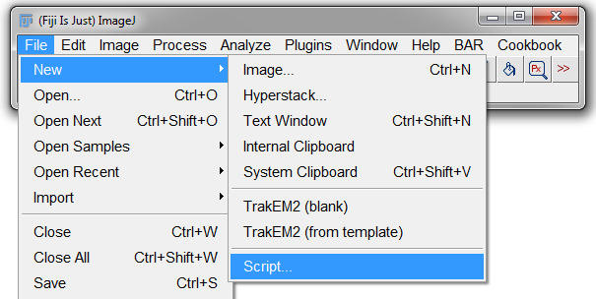
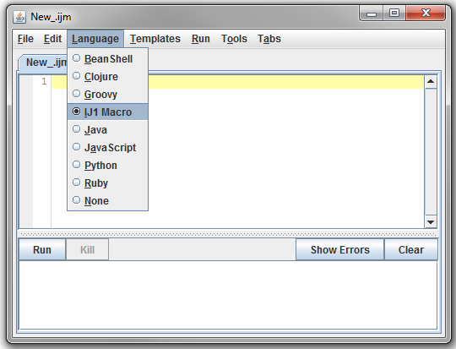
Setting up for macro writing
Start a new script
File > New > Script
Set language to IJ1 Macro
Language > IJ1 Macro

Slide 33
Exercise 1
Aims:
Print a simple message to the log window
Create a macro which makes use of two important concepts in programming:
A function
A string
The worksheet should provide all the information you need…!

Slide 34
Exercise 2
Aims:
This exercise introduces the use of more complex programming concepts to determine if numbers are odd or even:
First, we’ll create a for loop to list the numbers 1 to 10 in the log window
Then we’ll add some conditional statements to determine if the number is odd/even
Finally, well print a phrase which will say if the number is odd/even
Remember:
% - this will give you the remainder of division…may be useful for determining if even or odd…

Slide 35
Exercise 3
Aims:
This exercise introduces the use of dialog boxes
Create dialog box which will pose several questions to the user and allow them to input data to the programme
Create at least two questions (one string answer and one numerical answer)
Read these values in and assign to variables
Display a concatenated answer in the log window

Slide 36
Exercise 4
Aims:
Here we use the use the macro recorder:
With the macro recorder running, process the image using several functions
Run macro to process image stack automatically

Slide 37
Exercise 5
Aims:
Add GUI elements to your macro from ex 4.
Add option to change threshold level
Add option to change filter type

Slide 38
Exercise 6
Aims:
Calculate the distance between two objects in “two_nuc.tif”
Threshold nuclei image to create binary mask
Use Analyze particles function to find X and Y coordinates and store in results table
Read in coordinate information from results table and calculate straight line distance between the two nuclei

Slide 39
Exercise 7
Aims:
Create a macro to segment and measure the nearest neighbour distance for each nucleus in “Example_Data.tif”
Include a GUI for the user to input options (threshold, filter type, filter size etc.)
Update the results table to show the calculated nearest neighbour distance in the results table and save table as .csv file.
Display the nearest neighbour distance on the segmented image

